Slide 1
SYNTAX ANLYZER
-as a correction tool

Slide 2
Introduction
A syntax analyzer, also known as a parser, is a critical component of a compiler or interpreter that checks the source code for compliance with the grammar rules of a programming language.
The primary goal of a syntax analyzer is to ensure that the input code is syntactically correct and to create an abstract syntax tree (AST) that represents the structure of the code.
It can help identify errors by checking the input code against the grammar rules of the language and highlighting any syntax errors that are detected.
The syntax analyzer can also suggest possible corrections to the errors to help the programmer fix them quickly.

Slide 3
ABSTRACT : Problem Statement
One real-world problem that can be solved using a syntax analyzer is to detect and correct syntax errors in a program written in a programming language. Syntax errors are common mistakes made by programmers while writing code, such as misspelling a keyword, using incorrect syntax, or forgetting to close a bracket or parenthesis.
Our Project, shows the functionality of syntax analyzer wherein it improves the quality of the code and reduce the time and effort required to identify and correct syntax errors.

Slide 4
OBJECTIVE
The primary objective of our project is to develop a tool (parser) that can parse the input program and corrects the syntax of the given input program.
Our syntax analyzer should be able to identify common syntax errors such as misspelled keywords, incorrect syntax, and unmatched brackets or parentheses.
Provide meaningful error messages and suggestions for correction to help the programmer understand the nature of the errors and how to fix them.

Slide 5
Algorithm
Read the input program as a string.
Initialize a stack to keep track of brackets and parentheses.
Tokenize the input program into a sequence of tokens (e.g. keywords, identifiers, operators, and punctuation).
If the syntax error is caused by an unmatched bracket or parenthesis, push the opening bracket or parenthesis onto the stack when encountered and pop the stack when a closing bracket or parenthesis is encountered.
If the syntax error is caused by a misspelled keyword or an incorrect syntax, output an error message indicating nature of the error.
If the syntax error is caused by a wrong variable initialization, Output an error message indicating the location and nature of the error.
Repeat steps 4 to 6 for all statements and expressions in the input program.
End the program.

Slide 6
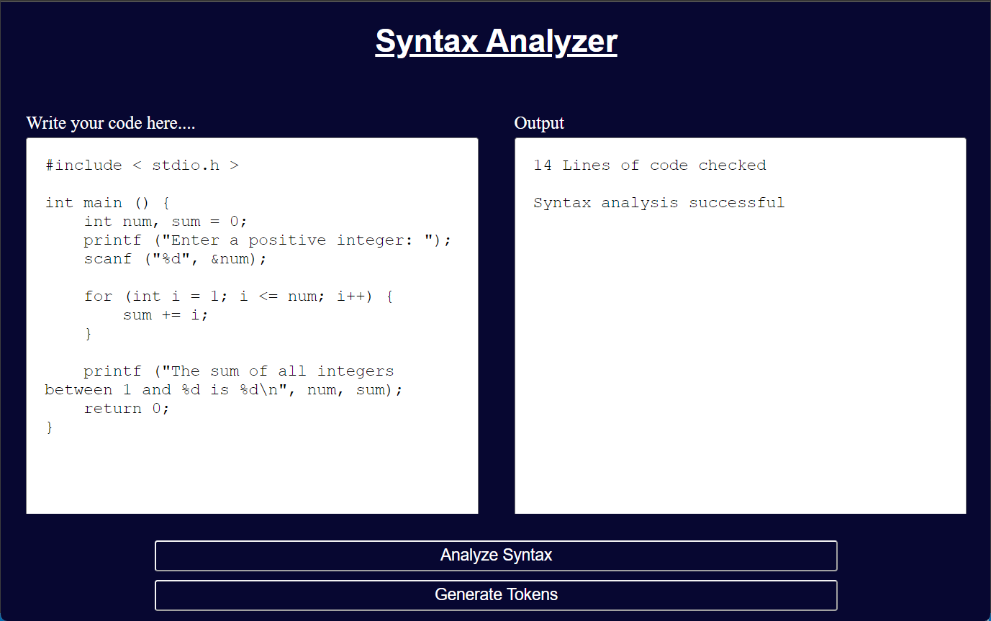
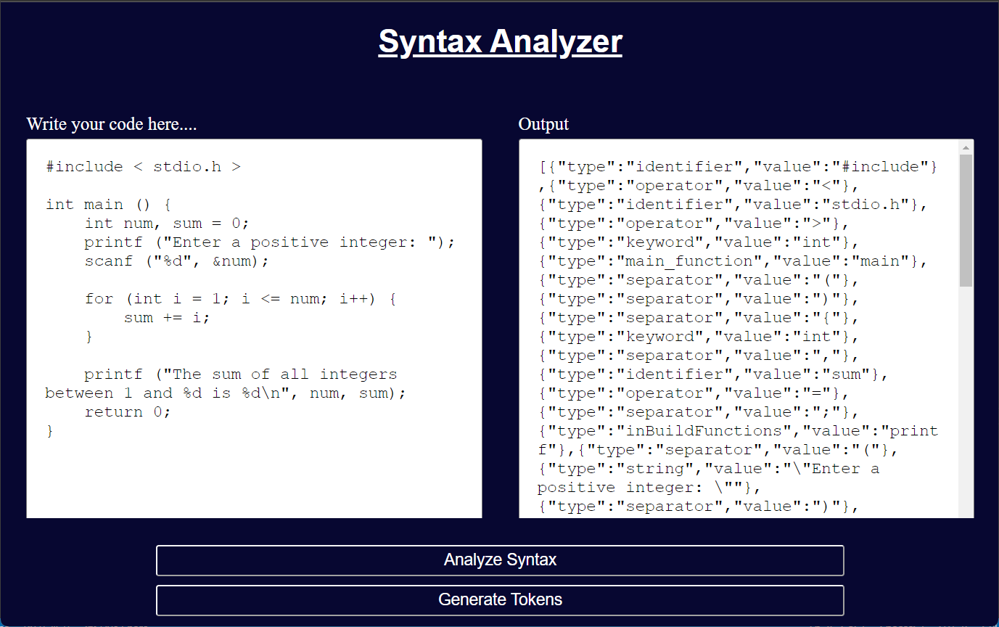
Implementation

Slide 7

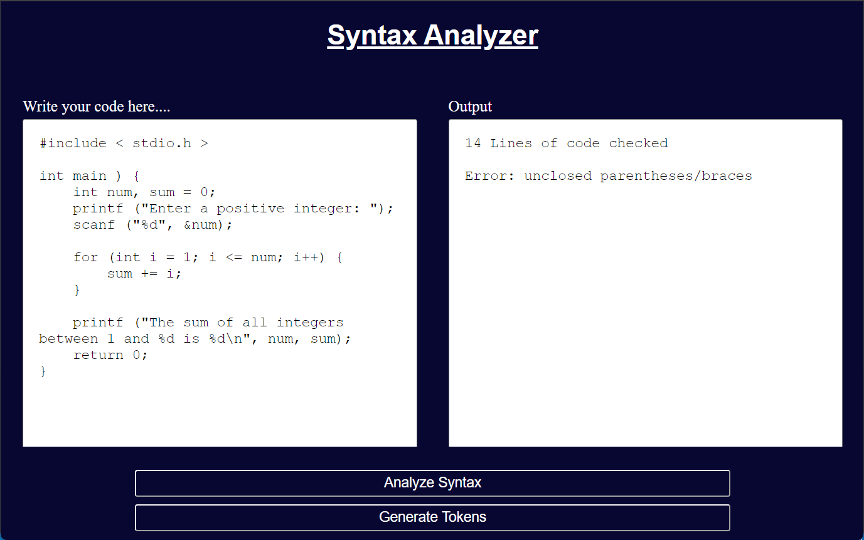
Implementation

Slide 8
Result
The program was successfully implemented and tested on a variety of input programs. It was able to detect syntax errors such as missing parentheses, misspelled keywords, and incorrect syntax.
In case of a syntax error, the program provided meaningful error messages and suggestions for correction to help the programmer understand the nature of the error and how to fix it.

Slide 9
Conclusion
In conclusion, the syntax analyzer program developed for this project is a valuable tool for programmers to check the syntax of their code and detect any errors. The program is able to parse the input code, identify syntax errors, and provide suggestions for correction in case of an error. By providing meaningful error messages and suggestions for correction, the program helps programmers to write correct and error-free code more efficiently and effectively. It is expected to be a valuable tool for software development teams, particularly those working on large-scale projects that require a high degree of accuracy and consistency.

Slide 10
References Used
"Modern Compiler Implementation in C" by Andrew W. Appel
https://www.geeksforgeeks.org/introduction-of-compiler-design
https://www.javatpoint.com/compiler-design-tutorial
https://ocw.mit.edu/courses/6-035-computer-language-engineering-spring-2010/pages/lecture-notes

